Slide 1
Azure Data Engineering Project (NYC-Taxi)

Slide 2
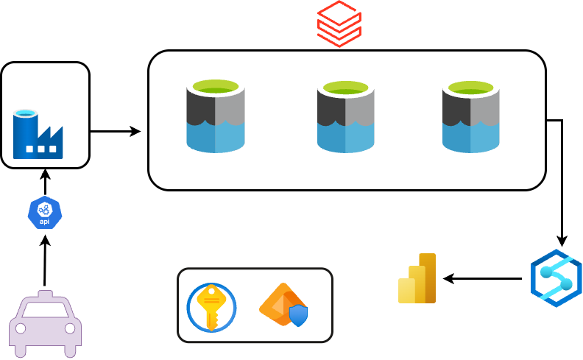
Transformation
Ingestion
Staging
Intermediate
Publish
Security
Taxi

